Slide 1

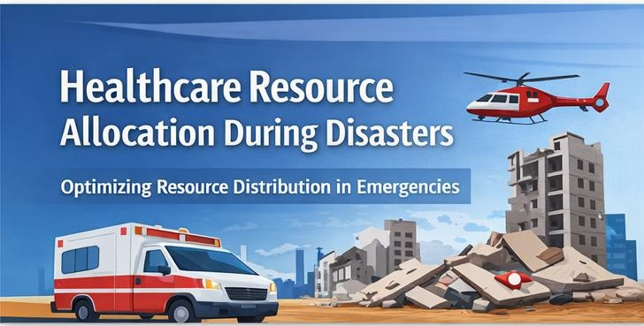
CSA0621 – Design and Analysis of Algorithms
CAPSTONE TITLE
Optimized Medical Resource Allocation During Disasters Using Greedy and Priority Scheduling Algorithms
Submitted By
R.Jayanth (192424286) A.M.Rakesh(192424393)
B.Abhishek(192472049)
Faculty Name: Dr.Nagarajan Govindasami

Slide 2
Abstract
Optimizes healthcare resources during disasters.
Estimates resource requirements at different locations.
Allocates ambulances, staff, and supplies efficiently.
Measures performance using response time, fairness, and resource utilization.
Displays allocation results through an emergency dashboard.

Slide 3
Introduction
Natural disasters create a sudden need for medical resources.
Hospitals may face shortages of ambulances, staff, and medical supplies.
Efficient resource allocation helps save lives and reduce response time.
Data science and optimization algorithms help distribute resources effectively.
The project simulates disasters and allocates healthcare resources using computational techniques.

Slide 4

Objectives
Displays disaster locations.
Shows available resources.
Tracks resource allocation.
Displays emergency response results.
Supports quick decision-making.

Slide 5

Problem Identification and Analysis
During disasters, medical resources are limited and demand increases suddenly.
Emergency response teams must decide how to
distribute resources quickly.
Poor allocation can lead to delayed medical assistance and increased casualties.
Manual decision-making may not be efficient in large- scale disasters.
Therefore, an automated system is needed to optimize
resource allocation and response planning.

Slide 6
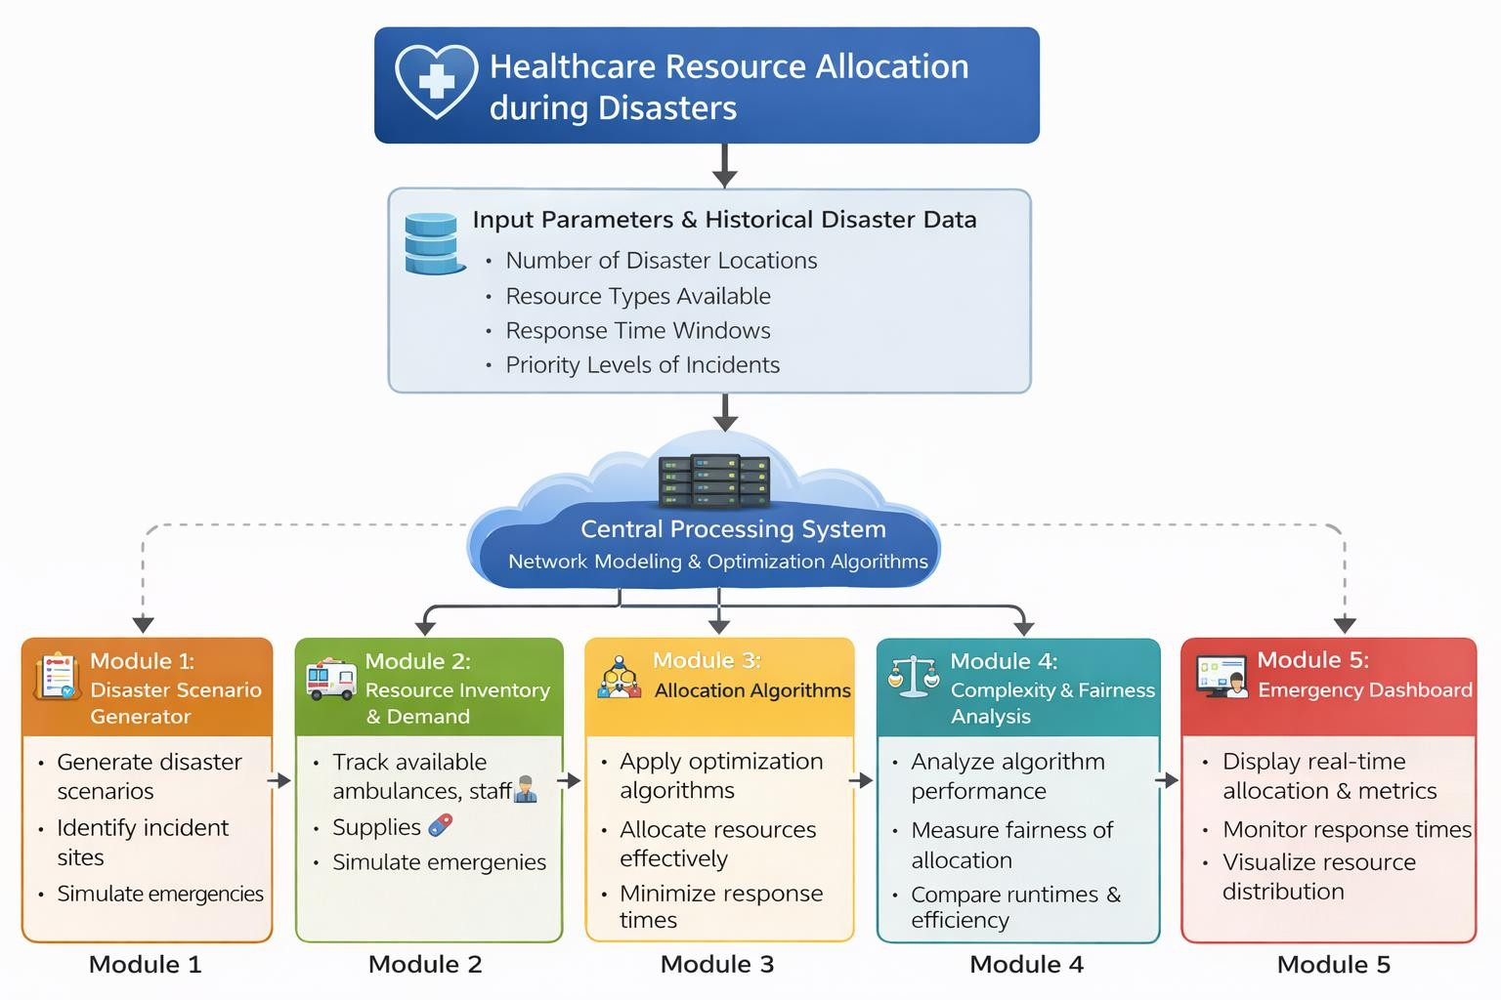

Slide 7

Project Requirements
Programming Language: Python
Libraries: NetworkX, PuLP, Pandas, Matplotlib
Data: Historical disaster data and GIS location data
Hardware: Computer with minimum 8GB RAM
Software: Python IDE such as Jupyter Notebook or VS Code

Slide 8

MODULE 1:Disaster Scenario Generator
Generates simulated disaster situations such as floods or
earthquakes.
Creates multiple incident locations with different severity levels.
Assigns priority levels based on severity and urgency.
Simulates demand for healthcare resources in each location.
Provides input data for the resource allocation algorithm.

Slide 9

MODULE 2:Allocation Algorithms
This module implements algorithms to distribute healthcare resources efficiently.
Optimization techniques are used to minimize response time.
Graph-based models help identify shortest routes between locations.
The system ensures priority-based allocation for
critical emergencies.
The output generates an optimal resource allocation plan.

Slide 10

MODULE 3:Emergency Dashboard
The dashboard provides real-time visualization of disaster locations.
It displays allocated resources such as ambulances and medical teams.
The system shows response time and allocation
efficiency metrics.
Interactive charts help analyze disaster management performance.
The dashboard supports decision-making for emergency response teams.

Slide 11

Solution Design and Implementation
A disaster simulation model will generate incident locations and severity levels.
Resource inventory will track available ambulances, medical staff, and supplies.
Allocation algorithms will assign resources based on
priority and demand.
Performance metrics will measure response time and fairness.
A dashboard will display resource distribution and system results.

Slide 12

Methodology
Generate disaster scenarios using simulated or historical data.
Identify affected locations and calculate healthcare demand.
Apply optimization algorithms to allocate available resources.
Simulate the distribution of ambulances, doctors, and medical supplies.
Analyze algorithm performance under
different time and priority constraints.

Slide 13

Future Enhancements
Integration with real-time disaster monitoring systems.
Use of machine learning models to predict disaster resource demand.
Integration with mobile applications for field responders.
Real-time GPS tracking of ambulances and emergency vehicles.
Cloud-based deployment for large-scale disaster management systems.

Slide 14
Results and Conclusion
The project demonstrates an efficient approach to allocate healthcare resources during disasters.
Simulation results show improved response time using optimized allocation algorithms.
The system ensures fair distribution of resources among multiple emergency locations.
Performance analysis helps identify the most efficient algorithm for disaster response.
Overall, the project provides a technological solution for better emergency healthcare management.

Slide 15
References
Altay, N., & Green, W. G. “OR/MS Research in Disaster Operations Management.” European Journal of Operational Research, 2006.
Van Wassenhove, L. N. “Humanitarian Aid Logistics: Supply Chain Management in High Gear.” Journal of the Operational Research Society, 2006.
Tzeng, G. H., Cheng, H. J., & Huang, T. D. “Multi-objective Optimal Planning for Designing Relief
Delivery Systems.” Transportation Research Part E, 2007.
Dantzig, G. B., & Thapa, M. N. Linear Programming 1: Introduction. Springer, 1997.
Ahuja, R. K., Magnanti, T. L., & Orlin, J. B. Network Flows: Theory, Algorithms, and Applications.
Prentice Hall, 1993.
Hagberg, A., Swart, P., & S. Chult, D. “Exploring Network Structure, Dynamics, and Function using NetworkX.” Proceedings of the Python in Science Conference, 2008.
Mitchell, S., O’Sullivan, D., & Dunning, I. PuLP: A Linear Programming Toolkit for Python. University of Auckland, 2011.
Sheu, J. B. “Dynamic Relief-Demand Management for Emergency Logistics Operations under Large-Scale Disasters.” Transportation Research Part E, 2007.
Python Software Foundation. Python Documentation. https://www.python.org
NetworkX Developers. NetworkX Documentation – Network Analysis in Python. https://networkx.org

Slide 16
THANK YOU!
“In times of disaster, the speed of help determines the value of hope.”

